Slide 1

Kallam
Haranadhareddy
Institute of
Technology

Slide 2
SENTIMENTAL ANALYSIS ON TWITTER
Presented by
Under the Esteemed Guidance of:
Dr.Ch.Anusha M.Tech Ph.D
Associate Professor
K.Sree Swetha(198X1A1256)
D.Anusha(198X1A1219)
CH.Satish(198X1A1212)
K.Venkat(198X1A1227)

Slide 3
Aim of the Project
The aim of this project is to extract people’s opinions from the twitter platform.

Slide 4
Abstract
The computational handling of views, feelings and subjectivity in text is known as Sentimental Analysis. With the rise of social networking, Internet has become a promising platform for online learning, exchanging ideas and sharing opinions. Social media contain huge amount of the sentiment data in the form of tweets, blogs, posts, etc. The main goal is to explore how text analysis techniques can be used to dig into some of the data in a series of posts focussing on different trends of tweets languages, tweets volume on twitter. Experimental evaluations show that the proposed ML classifiers are efficient and performs better in terms of accuracy. Twitter sentiment analysis is to extract users opinions and sentiments.

Slide 5
Introduction
People make judgments about the world around them when they are living in society. They make positive and negative attitudes about people, products, places and events. These types of attitudes can be considered as sentiments. Sentiment analysis is the study of automated techniques for extracting sentiments from written languages. Growth of social media has resulted in an explosion of publicly available, user generated text on the World Wide Web. These data and information can potentially be utilized to provide real-time insights into the sentiments of people.
This project reveals an approach which is implemented as a tool that can analyse sentiments on twitter social media addressing above issues and then develop an application to generate knowledge that can be useful for business environments using people’s attitudes about their products and services.

Slide 6
Problem Statement
The problem at hand consists of 2 sub tasks:
Phrase level sentimental analysis on twitter.
Sentence level sentimental analysis on twitter.

Slide 7
Objective
The objective of sentiment analysis is to accurately extract people's opinions from a large number of unstructured review texts and classifying them into sentiment classes, i.e., positive, negative, or neutral. Sometimes “highly positive” and “highly negative” are also considered.

Slide 8
Scope of the Project
This project will be helpful to the companies, political parties as well as a to the common people. It will be help full to political party for reviewing about the program that they are going to do or the program that they have performed. Similarly, companies also can get the review about their new product on newly released hardware or software. Also the movie maker can take the review on the currently running movie. By analyzing the tweets analyzer can get result on how positive or negative or neutral are peoples about it.

Slide 9
Literature Survey-Summary
Sentiment Analysis In Twitter Using Machine Learning
Authors: Neethu M S & Rajasree R
There are different Symbolic and Machine Learning techniques to identify sentiments from text. Machine Learning techniques are simpler and efficient than Symbolic techniques.

Slide 10
Twitter Sentiment Analysis
Authors: Aliza Sarlan, Chayanit Nadam & Shuib Basri
Twitter sentiment analysis is developed to analyze customers perspectives toward the critical to success in the marketplace. The program is using a machine-based learning approach which is more accurate for analyzing a sentiment; together with natural language processing techniques will be used.

Slide 11
Twitter Sentiment Analysis Using Machine Learning Algorithms: A Case Study
Authors: Sheresh Zahoor & Rajesh Rohilla
The sentiments can be predicted with more accuracy using Machine Learning algorithms especially Naïve Bayes, SVM, Random Forest Classifier and LSTM. These have found their use in the field of Natural Language Processing especially in Sentiment analysis.

Slide 12
Existing System
The existing system uses A query based approach for analyzing the data. This analysis provides lot of computational challenges for analyzing the data without distributed mechanism.
The data analysis is performed on a simple server environment without parallel processing.

Slide 13
Limitations of Existing System
When data size increases, computational process becomes a challenging thing.
No perfect visualization.
Parallel processing is not possible in clustering analysis.
Mining techniques does not work well with the big data in analysis when we occurred with multiple column analysis.

Slide 14
Proposed System
This project of analyzing class of tweets comes under the domain of "Pattern Classification" and "Data Mining". Both of these terms are very closely related and intertwined, and they can be formally defined as the process of discovering "useful" patterns in large set of data.
The project would heavily rely on techniques of "Natural Language Processing" in extracting significant patterns and features from the large data set of tweets and on "Machine Learning" techniques for accurately classifying individual unlabeled tweets according to whichever pattern model best describes them.

Slide 15
Advantages of Proposed System
We use statistical analysis with sampling data in the analysis.
The data visualization which is not done in the bigdata analysis.
Handles continuous and discrete data.
Not sensitive to irrelevant features.

Slide 16
Software Requirement Specifications
1.Functional Requirements
These are functions or the features that must be included in any system to satisfy the business need and be acceptable to the users. Based on this, the functional requirements that the system must require are as follows:
System should be able to process new tweets stored in database after retrieval.
System should be able to analyze data and classify each tweet polarity

Slide 17
2.Non-Functional Requirements
Software Requirements:
Operating System : Windows 7 and Higher Versions
Language : Python
Platform : Anaconda using Spyder
Hardware Requirements:
System : Intel core i3 and above
Hard Disk : 128 GB.
RAM : 4GB.

Slide 18
Modules Description
The entire work of this project is divided into 4 modules. They are :
Data Pre-processing: The pre-processing functions performed to process all input documents and texts are tokenization, normalization, Part-of-Speech (PoS) tagging.
Feature: The feature extraction and selection methods are performed from sci-kit learn python libraries. For feature extraction, we have used POS tagging.
Classification: The extracted features are fed into different classifiers, for predicting the sentiments of the tweets.
Prediction: Prediction is performed by taking the keyword as the input and now that we will find the word counts, we just have to convert them to probabilities and multiply them out to get the predicted classification.

Slide 19
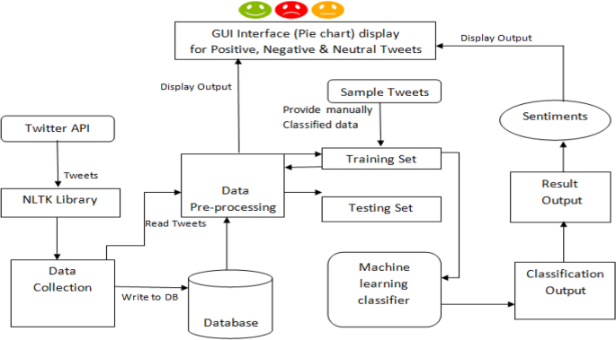
System Architecture

Slide 20
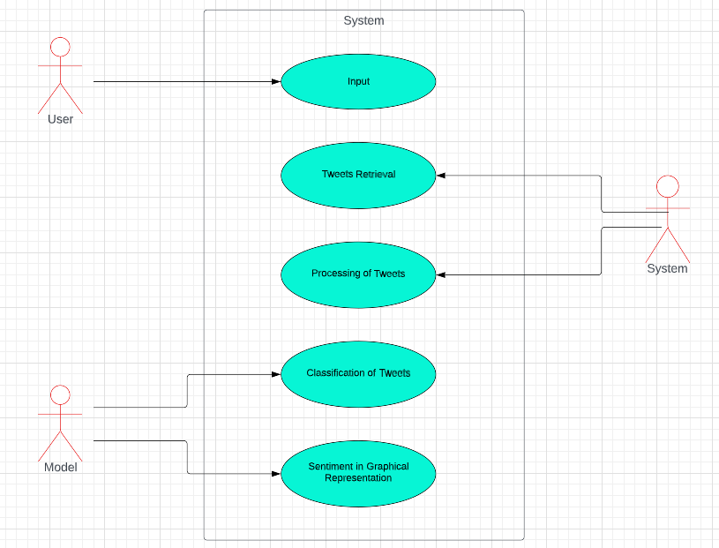
Use case diagram:

Slide 21
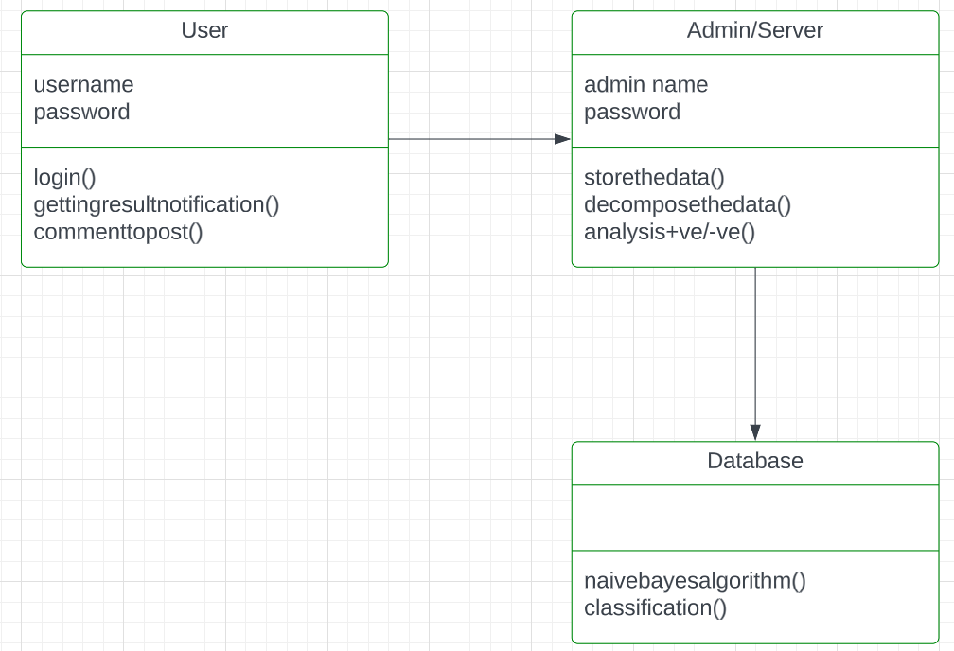
Class diagram:

Slide 22
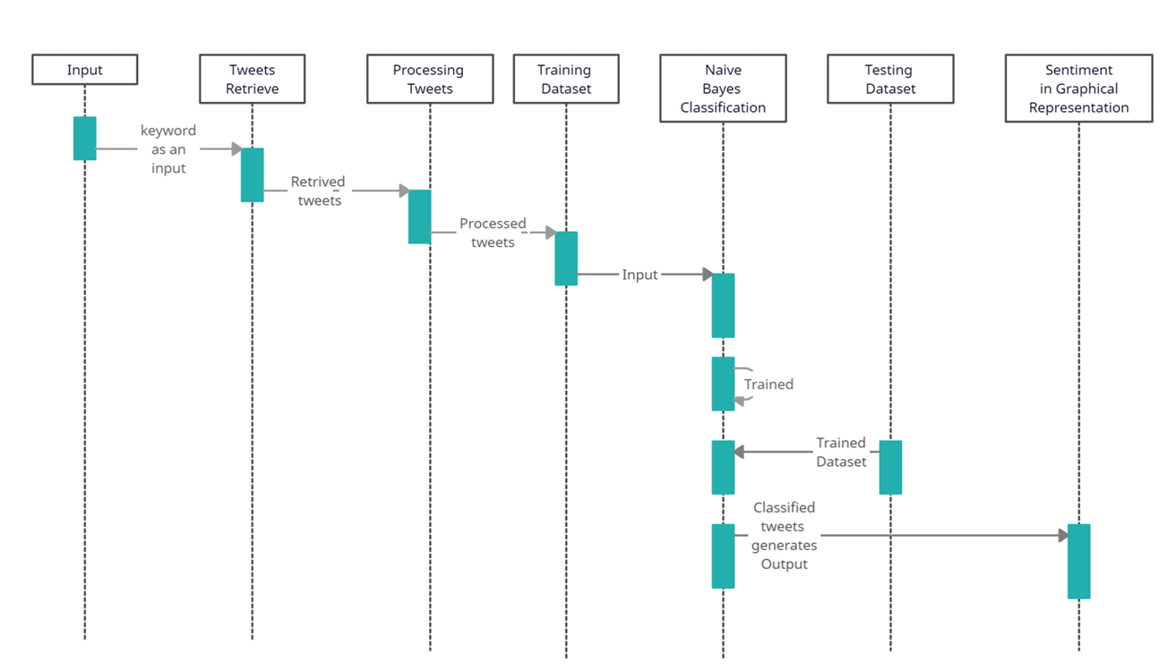
Sequence diagram:

Slide 23
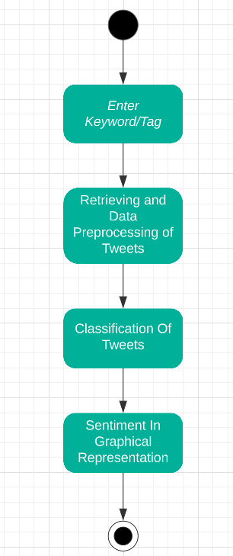
Activity diagram:

Slide 24
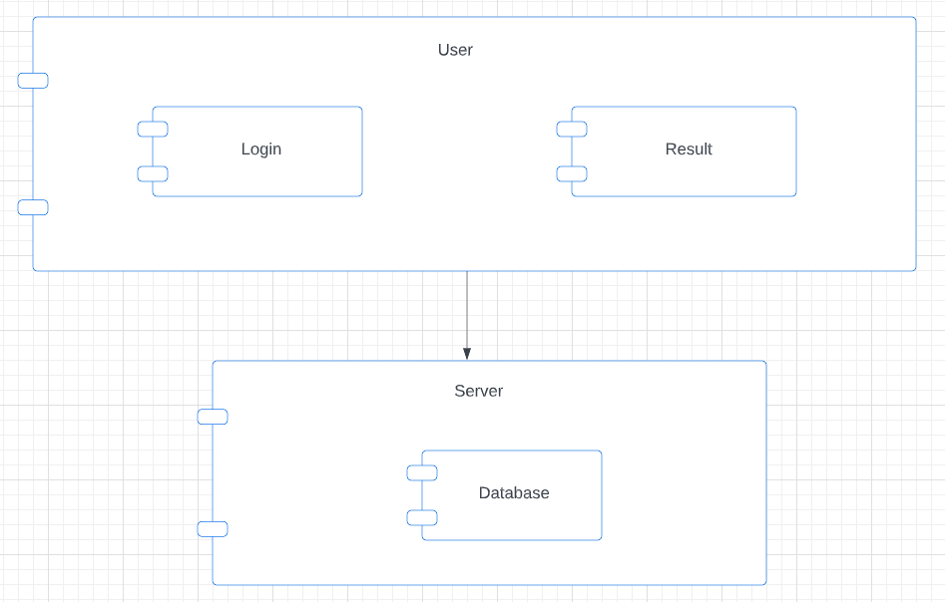
Component Diagram:

Slide 25
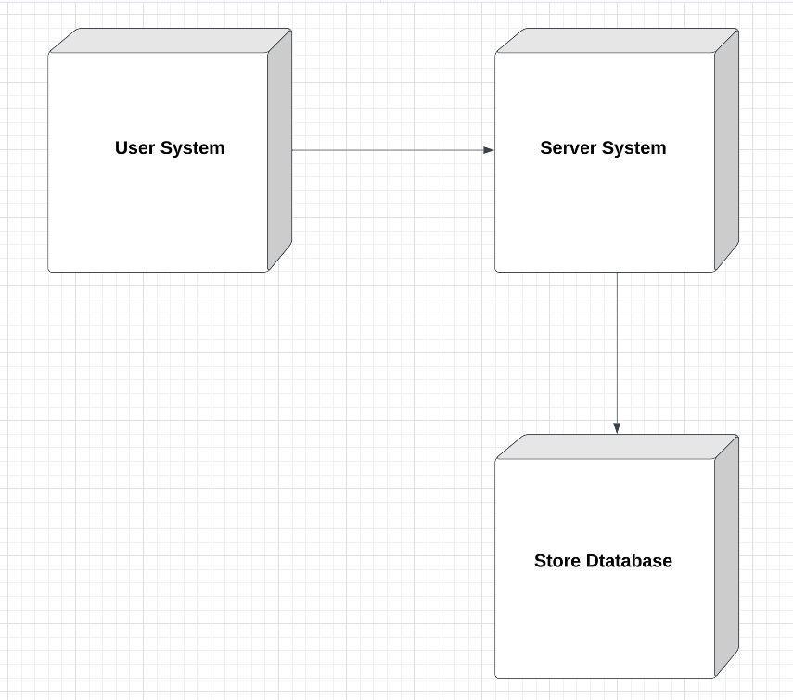
Deployment Diagram:

Slide 26
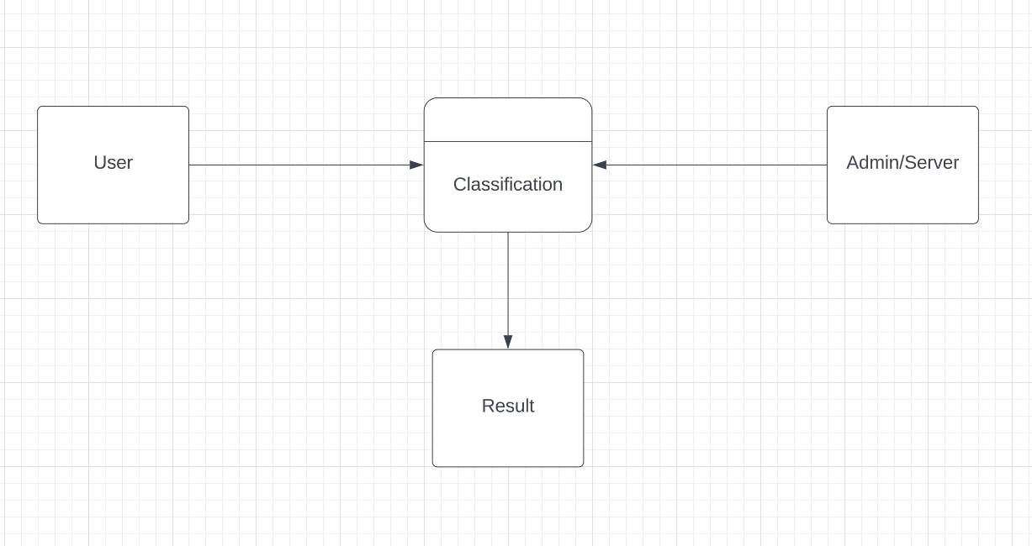
Flow Chart:
DFD level 0

Slide 27
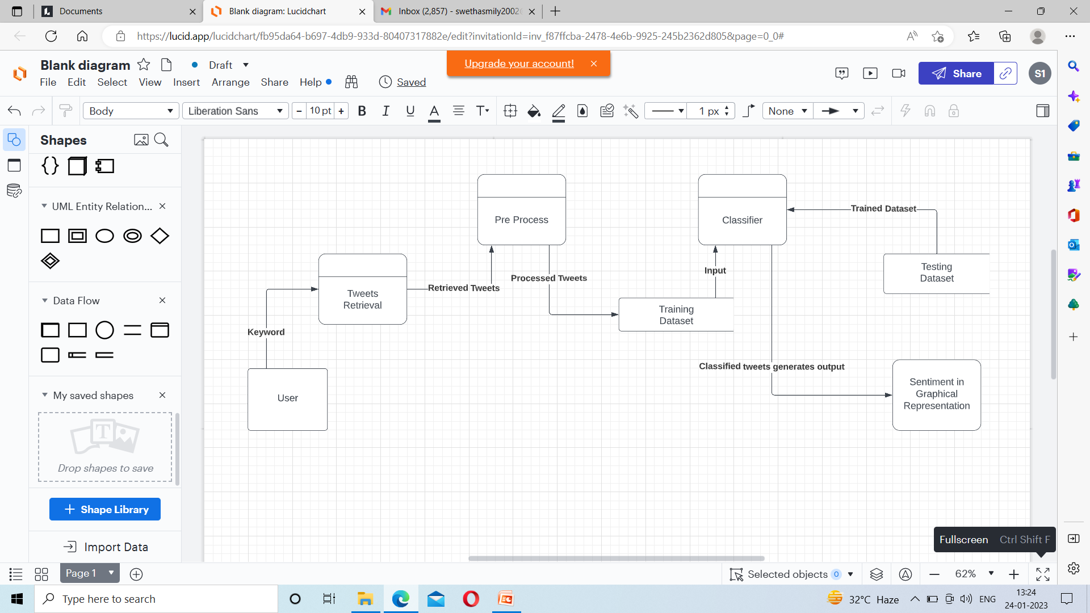
DFD level 1

Slide 28
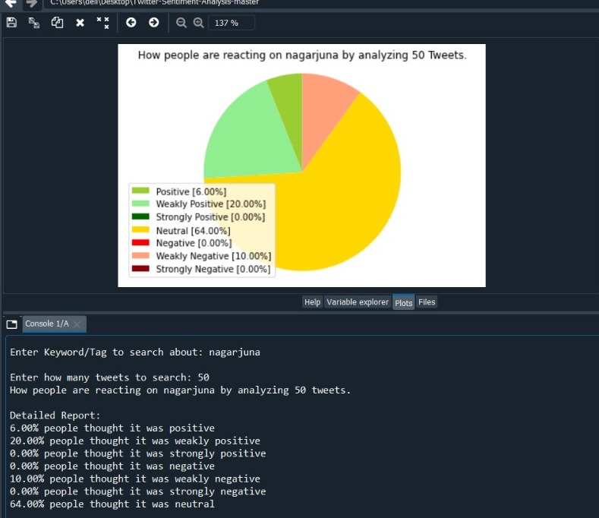
Test Case-1
Input: Valid username in twitter
Expected output: User data in twitter
Actual output: User data in twitter
Result: Pass.

Slide 29
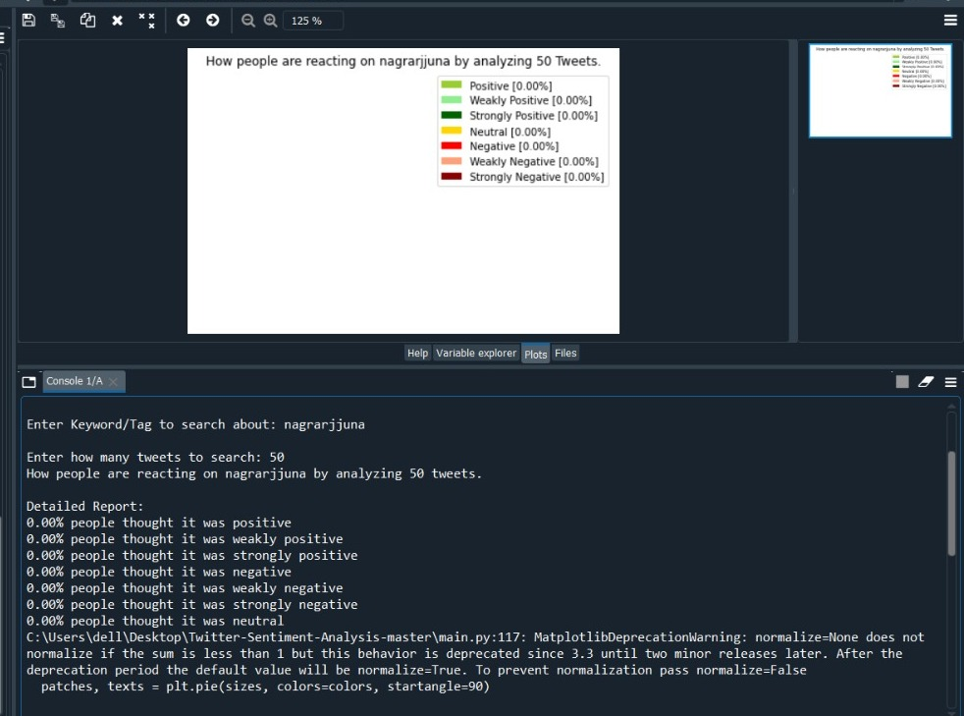
Test Case-2
Input: Invalid username in twitter
Expected output: Inappropriate data
Actual output: Inappropriate data
Result: Pass.

Slide 30
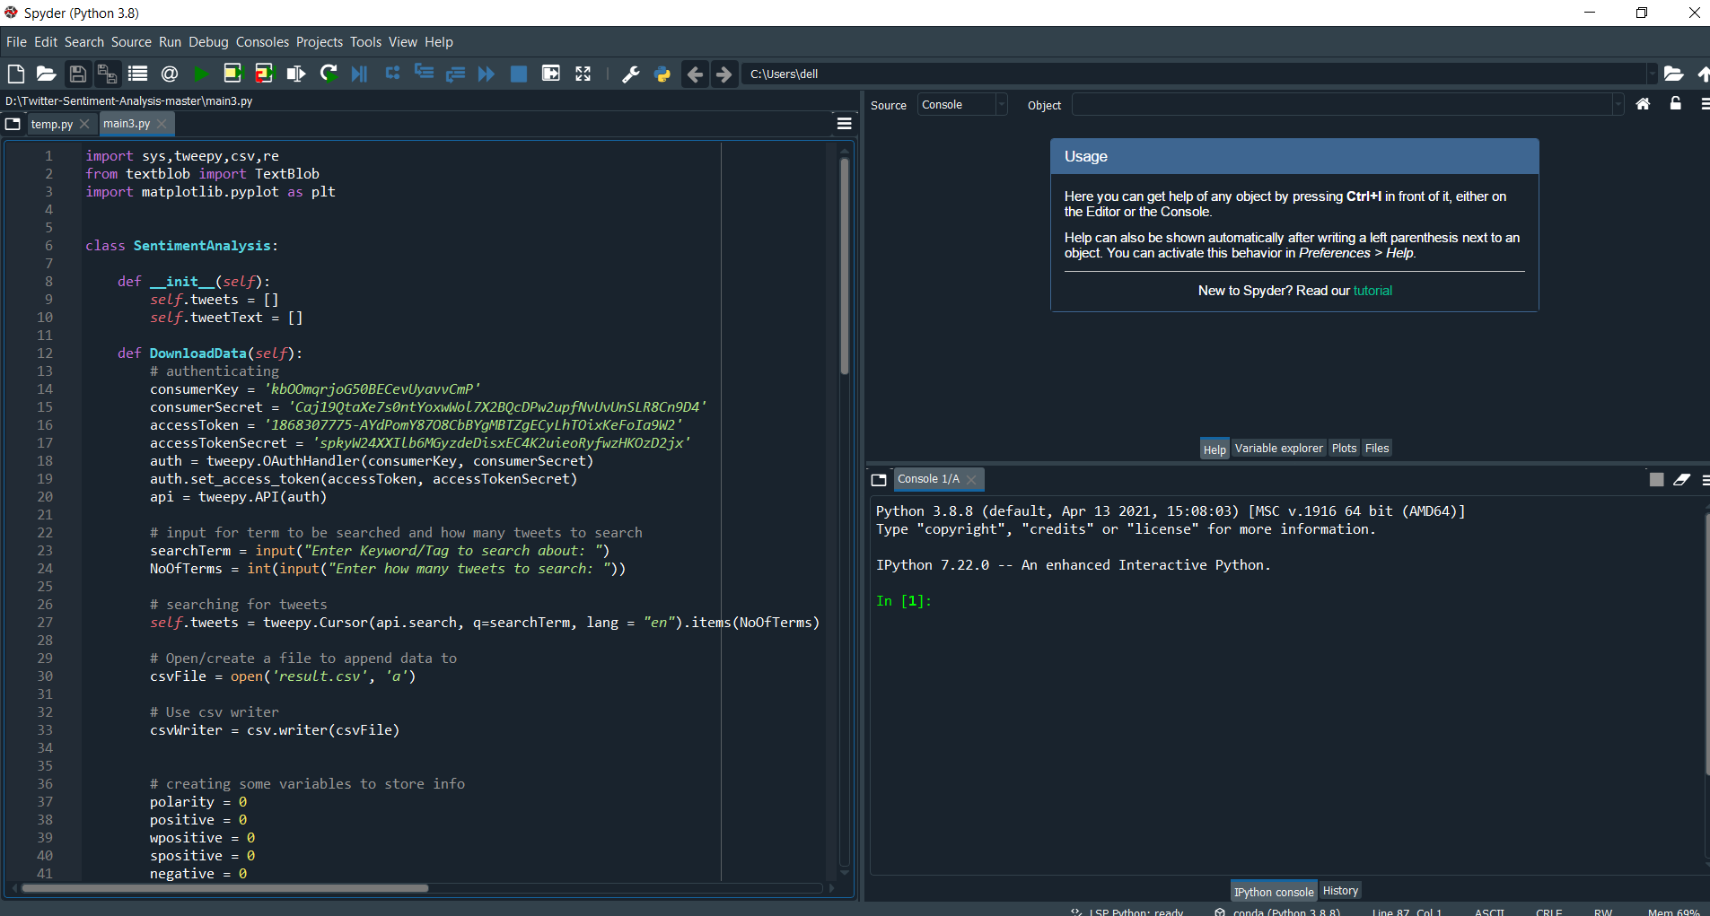
Output Screens

Slide 31
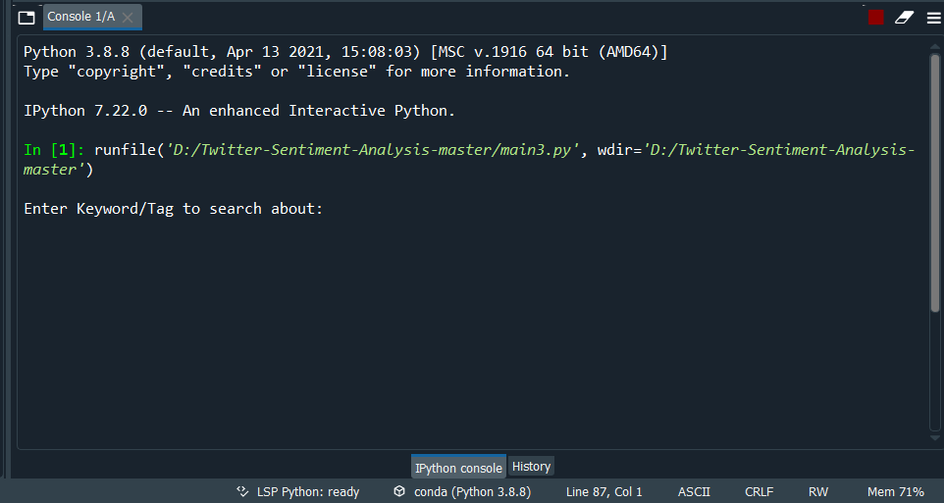

Slide 32
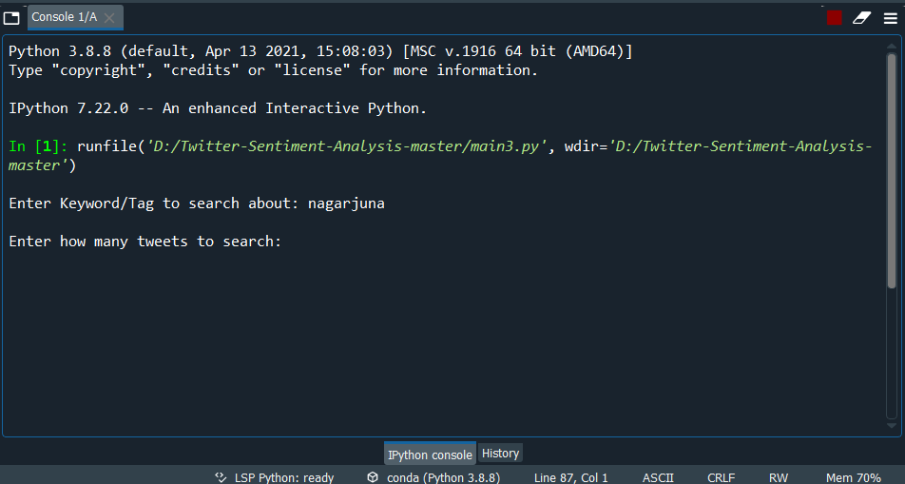

Slide 33
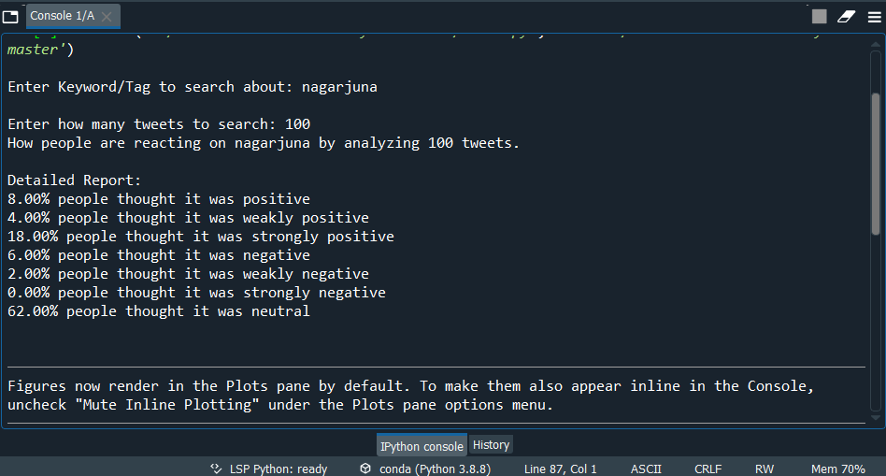

Slide 34
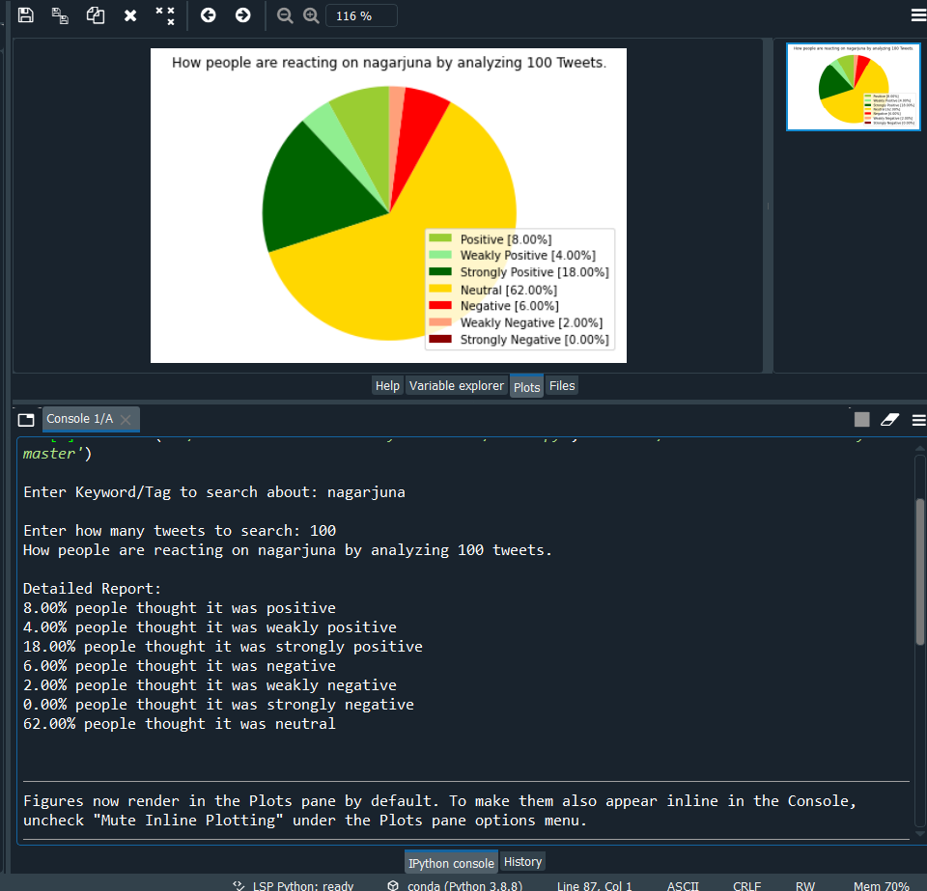

Slide 35
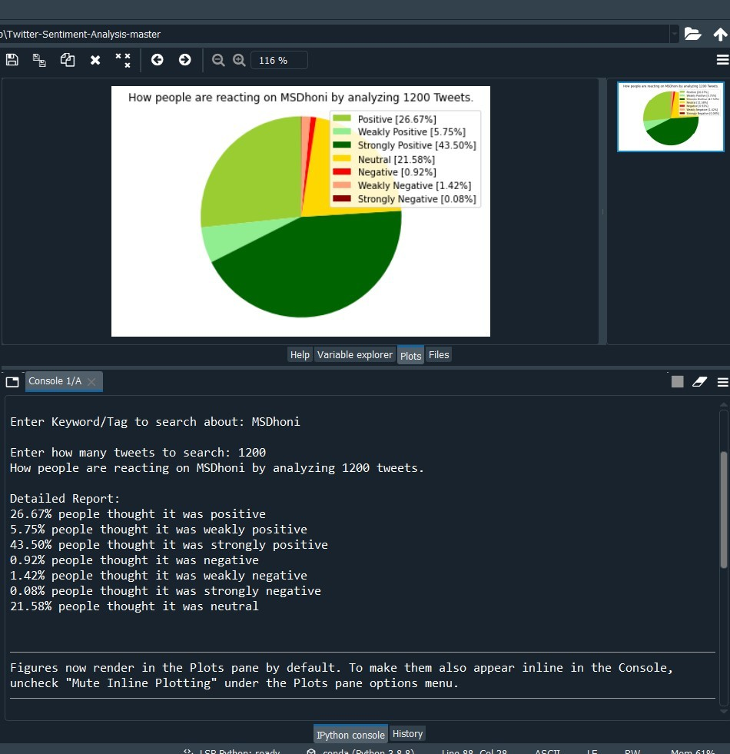

Slide 36
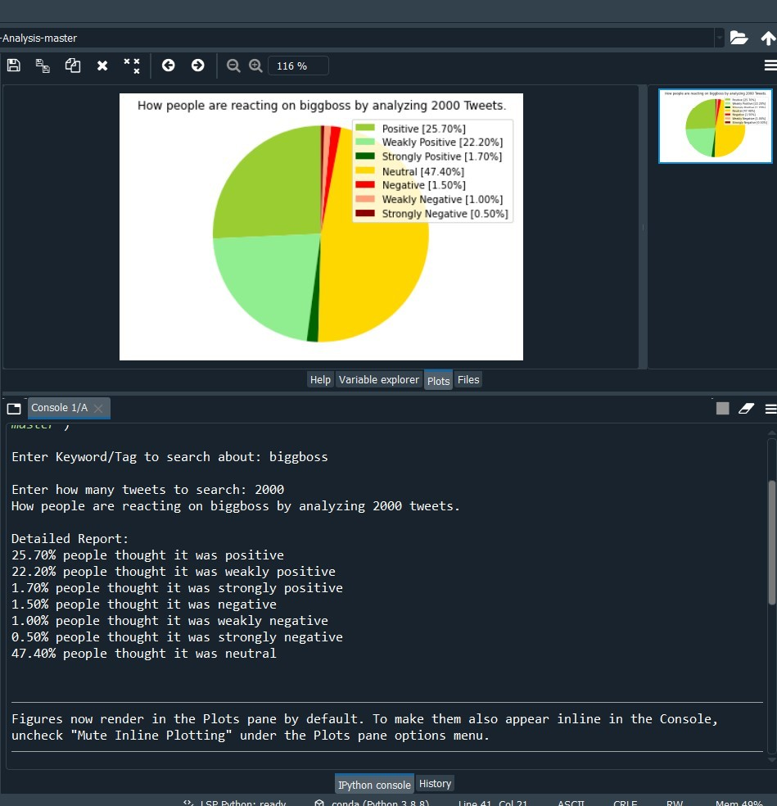

Slide 37
Conclusion
Twitter sentiment analysis is developed to analyze people's reactions towards a particular place, people, product, events etc. In this Naive Bayes machine learning classifier is handed down which is more accurate for analyzing a sentiment; at the same instant natural language processing techniques will be used. As an outcome, the model will categorize sentiment into strongly positive, positive, weakly positive, strongly negative, negative, weakly negative and neutral which is represented in a pie chart.

Slide 38
Future Enhancement
We are currently only focusing on unigrams and the effect of bigrams and trigrams may be explored. As reported in the literature review section when bigrams are used along with unigrams this usually enhances performance. However for bigrams and trigrams to be an effective feature we need a much more labeled data set than our meager 9,000 tweets.
This can be converted into an application for portability for android mobiles.
We can also add some enhancing features like corpus, to remove or block the un- parliamentary words.
Internationalization(Working on different languages) can be done.

Slide 39
References
[1] Google - https://en.wikipedia.org/wiki/Twitter
[2]Google-https://www.repustate.com/blog/sentiment-analysis-features
[3] Rachitha Sharma, “Sentiment Analysis of Tweets Using Machine Learning Approach” on https://ieeexplore.ieee.org/document/8530517
[4] Z. Niu, Z. Yin, and X. Kong, “Sentiment classification for microblog by machine learning,”in Computational and Information Sciences (ICCIS), 2012 Fourth International Conference on,pp. 286–289, IEEE, 2012.
[5] Efthymios Kouloumpis and Johanna Moore, IJCSI International Journal of Computer Science Issues, Vol. 9, Issue 4, No 3, July 2012
[6] S. Batra and D. Rao,”Entity Based Sentiment Analysis on Twitter”, Stanford University,2010

Slide 40
References
[7] Saif M.Mohammad and Xiaodan zhu ,Sentiment Analysis on of social media texts:,2014
[8]Ekaterina kochmar,University of Cambridge,at the Cambridge coding Academy Data Science.2016
[9] Manju Venugopalan and Deepa Gupta ,Exploring Sentiment Analysis on Twitter Data, IEEE 2015
[10] Brett Duncan and Yanqing Zhang, Neural Networks for Sentiment Analysis on Twitter.2017
[11] Afroze Ibrahim Baqapuri, Twitter Sentiment Analysis: The Good the Bad and the OMG!, Proceedings of the Fifth International AAAI Conference on Weblogs and Social Media.2011

Slide 41

Publication Certificates

Slide 42


Slide 43


Slide 44


Slide 45


Slide 46
ANY QUERIES ?

Slide 47
THANK YOU

